Slide 1
Design of a 32*1 MUX using 8*1 MUX
DIGITAL ELECTRONICS
MINOR PROJECT

Slide 2
Introduction to Multiplexer:
Multiplexer:-Multiplexer means many into one. A multiplexer is a circuit used to select and route any one of the several input signals to a signal output.
A multiplexer of (2^n ) inputs has n select lines, which are used to select one input line to send to the output.
A multiplexer is also called a “data selector”.
The multiplexer used for digital applications, also called digital multiplexer
Multiplexer is a circuit with many input but only one output By applying control signals, we can steer any input to the output.

Slide 3
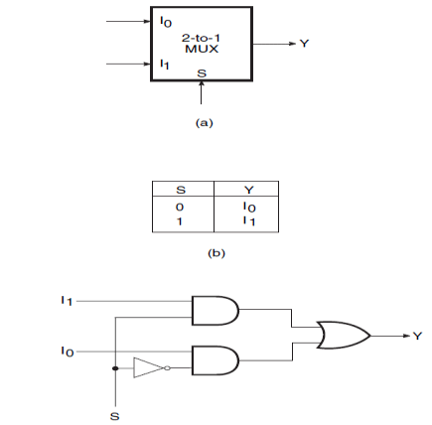
Types of multiplexers:-
Few types of multiplexer are 2-to-1, 4-to-1, 8-to-1, 16-to-1 , 32-to-1 multiplexer.
    2-to-1 multiplexer:-It is defined as circuit which consists of 2 inputs and one output with one selective line.

Slide 4
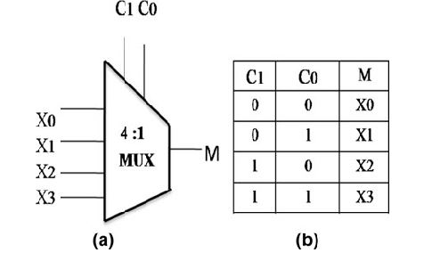
    2) 4-to-1 multiplexer:-It is defined as circuit which consists of 4 inputs and one output with tw0 selective line.

Slide 5
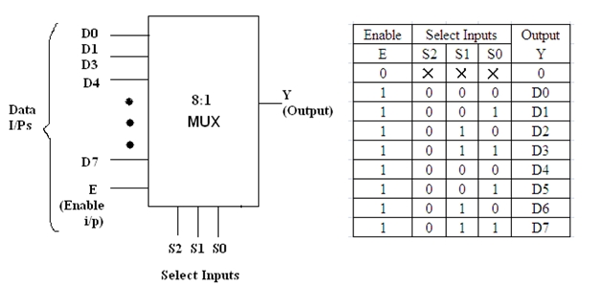
    3) 8-to-1 multiplexer:-It is defined as circuit which consists of 8 inputs and one output with three selective line.

Slide 6
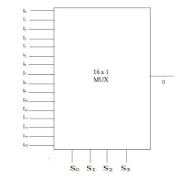
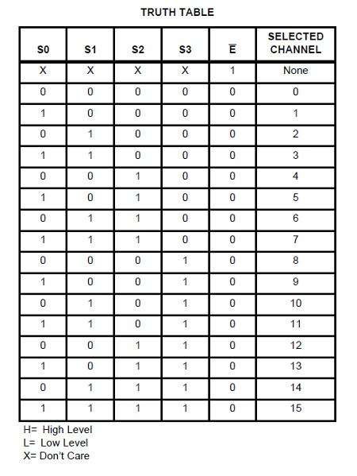
    4) 16-to-1 multiplexer:-It is defined as circuit which consists of 16 inputs and one output with four selective line.

Slide 7
    5) 32-to-1 multiplexer:-It is defined as circuit which consists of 32 inputs and one output with five selective line.
We required four 8-to-1 multiplexer in order to construct 32-to-1 multiplexer using (8-to-1) MUX.
Enable:- an input which decides whether the circuit has to operate or not .
(E=0) →out put =0
(E=1) → out put=1

Slide 8
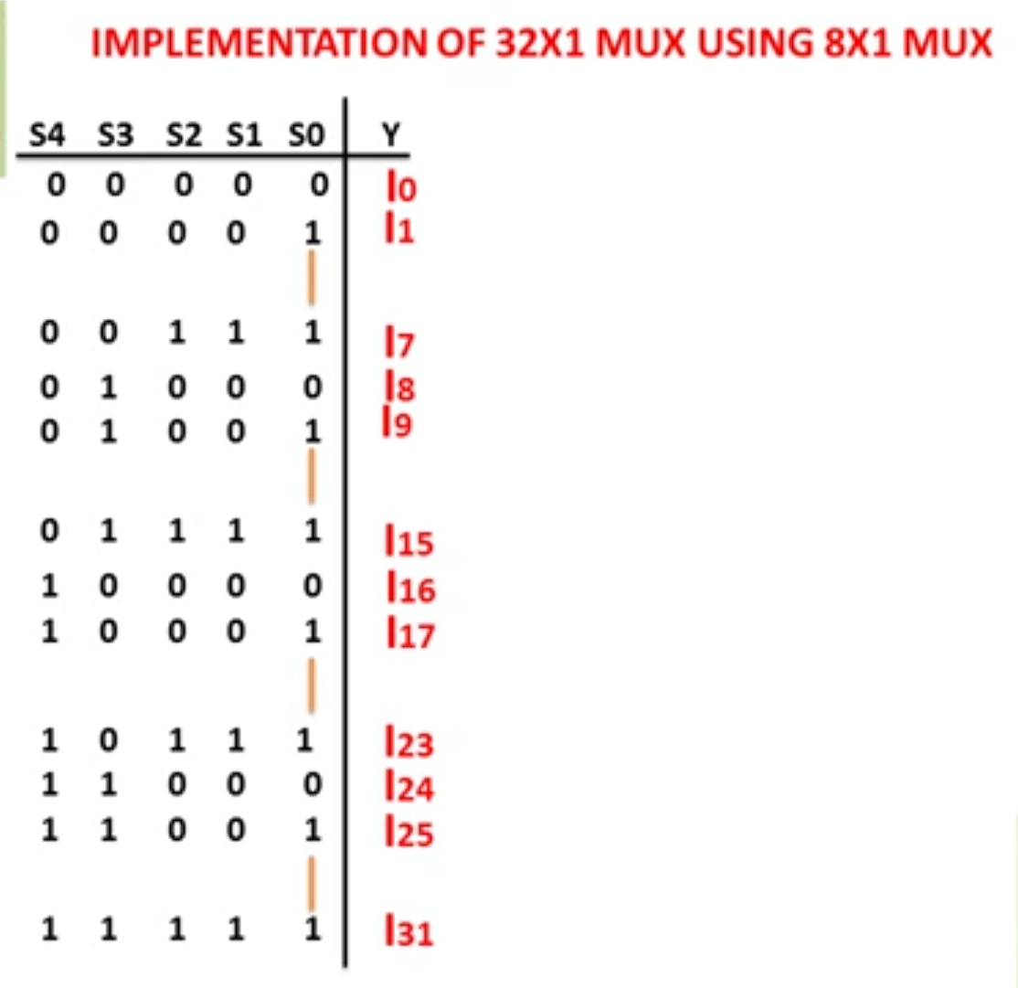
Truth table of (32*1) MUX

Slide 9
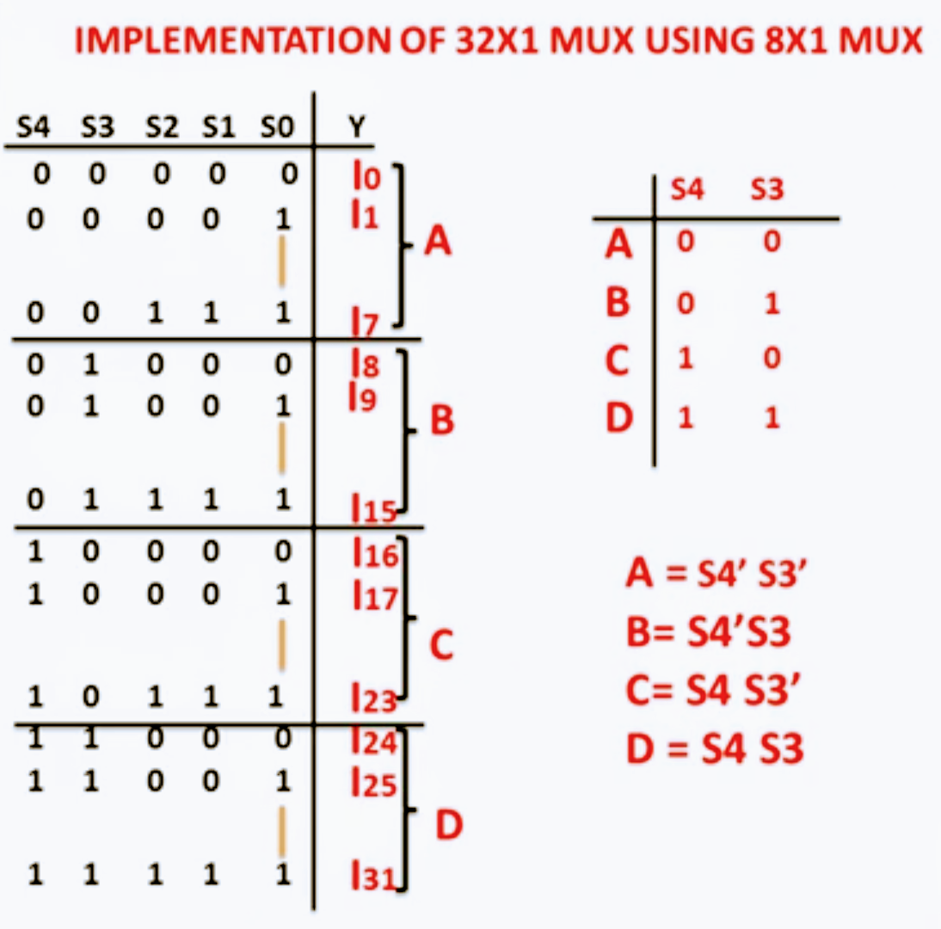

Slide 10
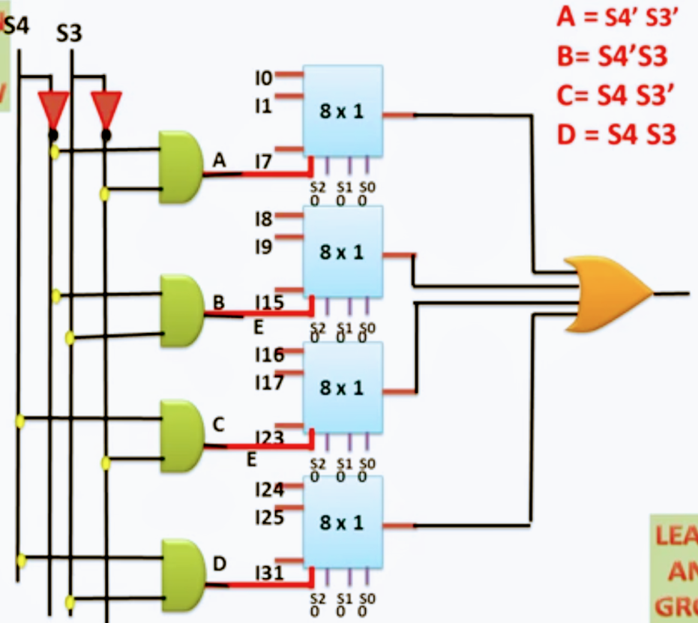
Circuit diagram of (32*1)MUX using (8*1)MUX

Slide 11
Applications of Multiplexer:
Multiplexer are used in various fields where multiple data need to be transmitted using a single line. Following are some of the applications of multiplexers -
1. Communication system – Communication system is a set of system that enable communication like transmission system, relay and tributary station, and communication network. The efficiency of communication system can be increased considerably using multiplexer. Multiplexer allow the process of transmitting different type of data such as audio, video at the same time using a single transmission line.
2. Transmission from the computer system of a satellite – Multiplexer can be used for the transmission of data signals from the computer system of a satellite or spacecraft to the ground system using the GPS (Global Positioning System) satellites.
3. Computer memory - Multiplexers are used to implement huge amount of memory into the computer, at the same time reduces the number of copper lines required to connect the memory to other parts of the computer circuit.

Slide 12
THE END

